Slide 1
Chapter 00_01
CS 58000-01 – Algorithm Design Analysis & Implementation (3 cr.)
Introducing Foundation

Slide 2
Body of Knowledge Coverage:
Software Development Fundamentals (SDF)
Algorithms and Design (SDF)
Concept and properties of algorithms,
Role of algorithms,
Problem-solving strategies,
Separation of behavior and implementation

Slide 3

Introduction –
What is an algorithm?
What is computer program?
What is a problem?
What are the parameters to a problem
What is an instance of the problem?
What is a solution of an instance of the problem?
What is an algorithm for the problem?

Slide 4
Introduction – What is an Algorithm?
An algorithm is
a well-defined procedure
a sequence of unambiguous instructions
for solving a well-specified computational problem
for obtaining a desired, required output
from any given legitimate input
in a finite amount of time.
{input specifications} Algorithm {output specifications}

Slide 5
Introduction – What is a computer program?
A computer program
composed of individual modules,
understandable (compiled/interpreted) by a computer,
that solve specific tasks (such as sorting, searching, …).
Our concern is
the design of these individual modules
that accomplish the specific tasks, which are called problems.
But NOT the design of entire programs

Slide 6
Introduction – What is a problem (task)?
A problem is a question to which we seek an answer.
An example of a problem 0.1.1:
Sort a list S of n numbers in nondecreasing order. (Question)
The answer is the numbers in sorted sequence.
An example of a problem 0.1.2:
Determine whether the number x is in the list S of n numbers. (Question)
The answer is yes if x is in S, and no if it is not.

Slide 7
Introduction – What are parameters to a problem?
They are variables without assigned specific values to the statement of the problem.
Example 0.1.1: An example of a problem
Question: Sort a list S of n numbers in nondecreasing order.
Answer: the numbers in sorted sequence.
The 2 parameters to the problem are:
S (the list) and n (the number of items in S).
The parameter n is redundant,
since its value is uniquely determined by S.
n facilitates the problems’ descriptions.

Slide 8
Introduction – What are parameters to a problem?
Example 0.1.2: An example of a problem
Question: Determine whether the number x is in the list S of n
numbers.
Answer: yes if x is in S and no if it is not.
The 3 parameters to the problem are:
S, n and the number x.
Again, the problem does not need the parameter n
since its value is uniquely determined by S.
n facilitates the problems’ descriptions.

Slide 9
Summary: Problem? Questions? Answers? Parameters? Instances of an problem? An instance’s Solution?
Introduction – What is an instance of the problem?
What is a solution of an instance of the problem?
A problem containing parameters represents a class of problems.
one for each assignment of values to the parameters.
An instance of the problem:
a specific assignment of values to the parameters.
A solution to an instance of a problem:
The answer to the question asked by the instance of a problem.

Slide 10
Summary: Problem? Questions? Answers? Parameters? Instances of an problem? An instance’s Solution?
Introduction – What is an instance and its solution of the problem?
Example 0.1.1: An example of a problem
Question: Sort a list S of n numbers in nondecreasing order.
Answer: the numbers in sorted sequence.
An instance of this problem in Example 0.1.1 is
An instance of the problem: S = [10, 7, 11, 5, 13, 8] and n = 6.
Solution: The solution to the instance is [5, 7, 8, 10, 11, 13].

Slide 11
Summary: Problem? Questions? Answers? Parameters? Instances of an problem? An instance’s Solution?
Introduction – What is an instance and its solution of the problem?
Example 0.1.2: An example of a problem
Question: Determine whether the number x is in the list S of n
numbers.
Answer: The answer is yes if x is in S and no if it is not.
An instance of the problem in Example 0.1.2 is
S = [10, 7, 11, 5, 13, 8], n = 6, and x = 5.
The solution to this instance is, “yes, x is in S”.

Slide 12
Introduction – What is an algorithm for the problem?
An algorithm must specify
a step-by-step procedure
for producing the solution to each instance.
We say that the algorithm solves all instances of the problem.

Slide 13
Introduction – What is an algorithm for the problem?
Example 0.1.2: An example of a problem
Question: Determine whether the number x is in the list S of n
numbers.
Answer: yes if x is in S and no if it is not.
An algorithm for the problem in Example 0.1.2:
Starting with the first item in S,
compare x with each item in S in sequence
until x is found or S is exhausted.
If x is found, answer yes;
if x is not found, answer no.

Slide 14

Algorithm A 1.1 Sequential Search
A 1.1 Sequential Search
Problem Given: Is the key K in the array S of n keys?
Inputs (parameters): A positive integer n, array of keys S indexed from 0
to n-1 and a key K.
Outputs: The index (location) of the first found element of S that
matches K, or -1 if there are no matching elements.

Slide 15
Algorithm SequentialSearch(S[0 .. n-1], K)
// Searches for a given value K in a given array S by sequential search
Input: An array S[0 .. n-1] and a search key K
Output: The index (location) of the first element of S that matches K
or -1 if there are no matching elements
i := 0;
while (i < n and S[i] ≠ K)
do {i := i + 1; }
if (i < n) return i;
else return -1;
Q: Which is the basic operation? Why?
What is the running time (in terms
of execution time)?

Slide 16
Compare their running time:
Algorithm SequentialSearch(S[0 .. n-1], K)
// Searches for a given value K in a given array S[0 .. n-1] by sequential search
i := 0;
while (i < n and S[i] ≠ K)
do {i := i + 1; }
if (i < n) return i;
else return -1;
Q: Which is the basic operation? Why?
Is there any difference in terms of execution time,
if we design the while-do as the following?
Which one costs the most?
i := 0;
while (i < n)
{if (S[i] ≠ K) {i := i +1;}}//end while-do
if (i < n) return i;
else return –i;
Or
i := 0;
while (i < n)
do { if (S[i] = K) {return i;}
i := i +1;} //end while-do
return -1;

Slide 17
Algorithm SequentialSearch(S[0 .. n-1], K)
// Searches for a given value K in a given array S by sequential search
Input: An array S[0 .. n-1] and a search key K
Output: The index (location) of the first element of S that matches K
or -1 if there are no matching elements
S[n] := K;
i := 0;
while (S[i] ≠ K)
do {i := i + 1; }
if (i < n) return i;
else return -1;
Q:
Which is the basic operation? Why?
Is there any difference in terms of execution time between this algorithm and the previous one? Why?
i := 0;
while (i < n and S[i] ≠ K)
do {i := i + 1; }
if (i < n) return i;
else return -1;

Slide 18

Basic questions about an algorithm
In designing and analyzing an algorithm, the following questions are considered.
What is the problem we have to solve? Does a solution exist?
Can we find a solution (algorithm), and is there more than one solution?
Is the algorithm correct?
Does it halt? (halting problem)
Is it correct? (partial correctness)
How efficient is the algorithm?
Is it fast? (Can it be faster?) (time efficient)
How much memory does it use? (space efficient)
How does data communicate? (data representation/implementable)
Need to know about
Design and modeling techniques
Resources – avoid reinventing the wheel

Slide 19
Logical methods of checking the correctness
of an algorithm with respect to its input and output.
Testing
Correctness proof
Confidence in algorithms from testing and correctness proof
Correctness of recursive algorithms: prove directly by induction
Correctness of iterative algorithms: prove using loop invariants and induction

Slide 20
Testing vs Correctness Proofs
Testing
Try the algorithm on sample inputs
Testing may not find obscure bugs
Correctness Proof
Prove mathematically can also contain bugs.
Use a combination of testing and Correctness proofs

Slide 21
Analysis, Design and Implementation of an Algorithm:
1.0 Analysis of Algorithms?
Study the complexity of an algorithm according to
time efficiency and
space efficiency (the amount of resources required to run an algorithm).

Slide 22
Analysis, Design and Implementation of an Algorithm:
1.1 Why Analyze an Algorithm?
Reasons for analyzing an algorithm are:
Discover an algorithm’s characteristics
Evaluate its suitability for various applications
Compare it with other algorithms for the same application.
Understand it (algorithm) better, and
Improve it.
Algorithms tend to become shorter, simpler, and more elegant during the analysis process.

Slide 23
Analysis, Design and Implementation of an Algorithm:
1.2 Computational Complexity.
In theoretical computer science,
the study of computational complexity theory focuses on studying the complexity of problems:
The complexity of a problem is the complexity of the best algorithms that allow solving the problem.
Study the complexity of computational problems according to their inherent difficulty and relate those complexity classes to each other. e.g., TSP is a NP problem.

Slide 24
1.2 Computational Complexity.
In theoretical computer science,
the study of computational complexity theory focuses on classifying:
algorithms according to time and space efficiency, such as O(n²)
computational problems, based on their inherent difficulty,
into classes, such as P (Polynomial) class, and NP class.
They focus on order-of-growth worst-case performance.
Such classifications are not useful for
predicting performance or
comparing algorithms in practical applications.
We focus on analyses that can be used to predict performance and compare algorithms.

Slide 25
1.3 Analysis of Algorithms.
A complete analysis of the running time of an algorithm involves the following steps:
[input] Develop a realistic model for the input to the program.
[input size] Analyze the unknown quantities of the modeled input.
[algorithm development] Implement the algorithm completely.
[algorithm analysis]
Determine the time required for each basic operation.
Identify unknown quantities that can be used to describe the frequency of execution of the basic operations.
[efficiency] Calculate the total running time by
multiplying the time by the frequency for each operation,
then adding all the products.
What are the domain of data and the representation of data?

Slide 26
1.3 Analysis of Algorithms.
Efficiency
Software is always outstripping hardware
need faster CPU, more memory for the latest version of popular programs
Given a problem:
what is an efficient algorithm?
what is the most efficient algorithm?
does there even exist an algorithm?

Slide 27
1.3 Analysis of Algorithms.
How to measure efficiency
Machine-independent way:
analyze the “pseudocode” version of the algorithm
Assume an idealized machine model
One instruction takes a one-time unit
"Big-Oh" notation (order of growth)
order of magnitude as problem size increases
Worst-case analyses
provides an upper bound on time taken by the algorithm.
The only “safe” analysis.
Average case analysis
requires making some assumptions about the probability distribution of the inputs

Slide 28
1.4 Several Important Problem Types
Specifying and implementing algorithms
Basic complexity analysis
Sorting
a set of items
Searching
among a set of items
String processing
text, bit strings, gene sequences
Graphs
model objects and their relationships
Network flow algorithms
Tree traversals/State space search
Combinatorial
find desired permutation, combination, or subset
Geometric
graphics, imaging, robotics
Numerical
continuous math: solving equations, evaluating functions

Slide 29
1.5 Algorithm Design Strategies/Techniques.
Simple Recursion
Brute Force & Exhaustive Search
follow definition / try all possibilities
Divide & Conquer
break problem into smaller subproblems
Transformation
convert the problem to another one
Greedy
repeatedly do what is best now
Dynamic Programming
break problem into overlapping subproblems
Backtracking and Branch and Bound
Iterative Improvement
repeatedly improve the current solution
Randomization
use random numbers
Space and Time Tradeoffs

Slide 30
Divide and Conquer
Break the problems into smaller sub-problems
Solve each of the sub-problems
Combine the solutions to obtain the solution to the original problem
Examples
Binary search in a sorted array (recursion)
Quick sort algorithm (recursion)
Merge sort algorithm (recursion)

Slide 31
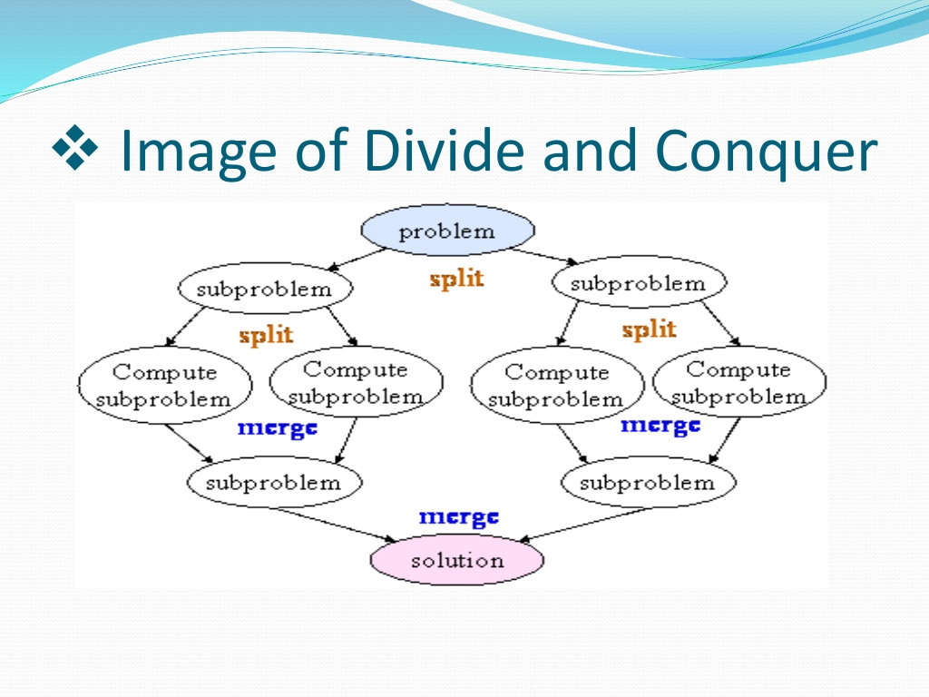
Divide and Conquer

Slide 32
Input: An array S[0 .. n-1] and a search key K
Output: The index (location) of the first found element of S that matches K
or -1 if there are no matching elements
Method: Use sequential search. The order of growth is O(n).
Use binary search. The order of growth is O( log₂ n).
Analysis: For using binary search, it requires sorting the given array S in order.
Use merge sort or quick sort algorithm, which requires O(n log₂ n).
Therefore, the total time would be T(n) = O(n log₂ n) + O( log₂ n).

Slide 33
Greedy Algorithms
An algorithm always takes the best immediate or local solution while finding an answer.
Greedy algorithms
always find the overall or globally optimal solution for some optimization problems,
but may find less-than-optimal solutions for some instances of other problems.
Examples: Greedy algorithm for
the Knapsack problem – a combinatorial optimization pbm
Minimal spanning tree - minimum weight spanning tree for a weighted, connected, undirected graph

Slide 34
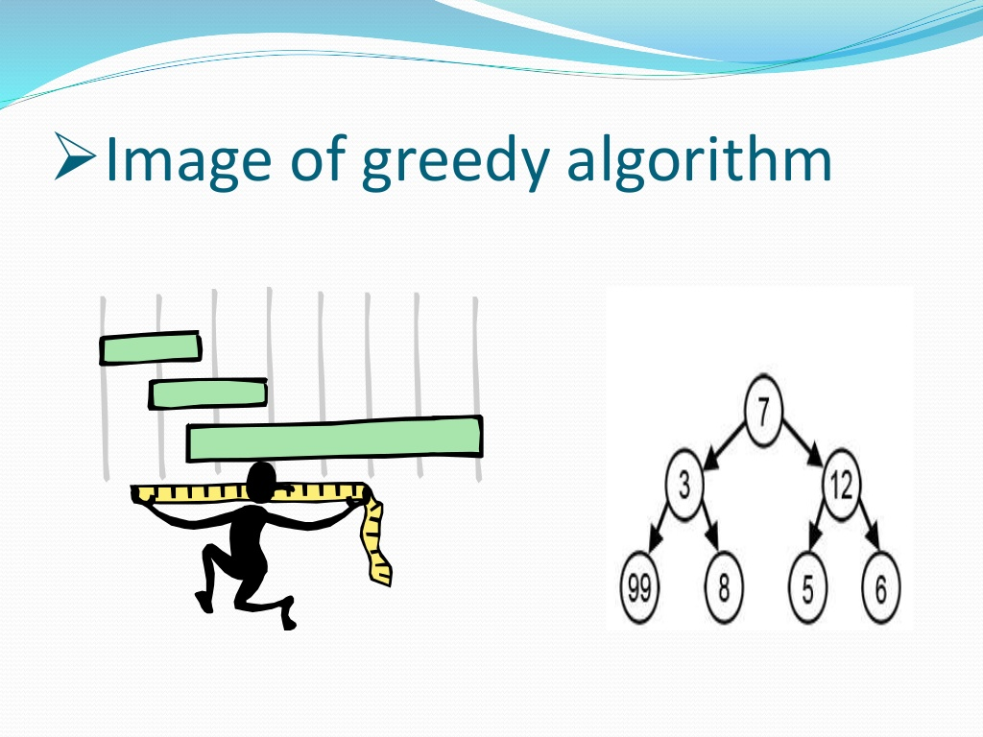
Greedy Algorithm

Slide 35
Dynamic Programming
used to solve an optimization problem that requires the principle of optimality:
An optimal solution to any instance of an optimization problem is composed of optimal solutions to its sub-instances.
Is a bottom-up technique
Solve the smallest sub-instances first and
Use the results of these to construct solutions to progressively larger sub-instances.
Examples
Fibonacci numbers are computed by iteration.
Warshall’s algorithm for computing all paths in a directed graph is implemented by iterations.

Slide 36
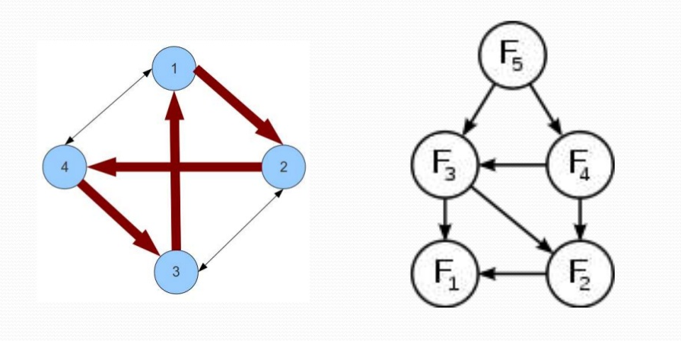
Dynamic Programming

Slide 37
BackTracking
Backtracking is a general algorithm for finding all solutions to some computational problem
incrementally builds candidates to the solutions, and
abandons each partial candidate c ("backtracks") when it determines that c cannot possibly be completed to a valid solution.
Examples
Eight queens puzzle.
Traveling salesman problem (TSP).

Slide 38
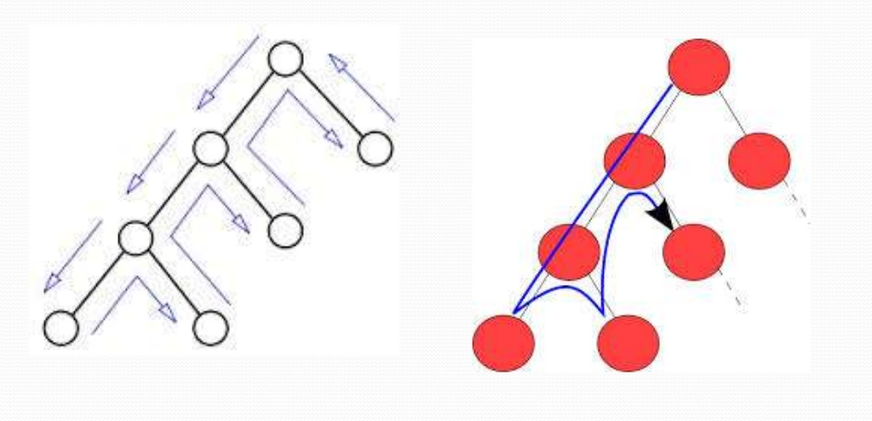
Backtracking

Slide 39
Graph Algorithm
A graph algorithm takes one or more graphs as inputs.
Performance constraints on graph algorithms are generally expressed in terms of
the number of vertices (|V|) and
the number of edges (|E|)
in the input graph.

Slide 40
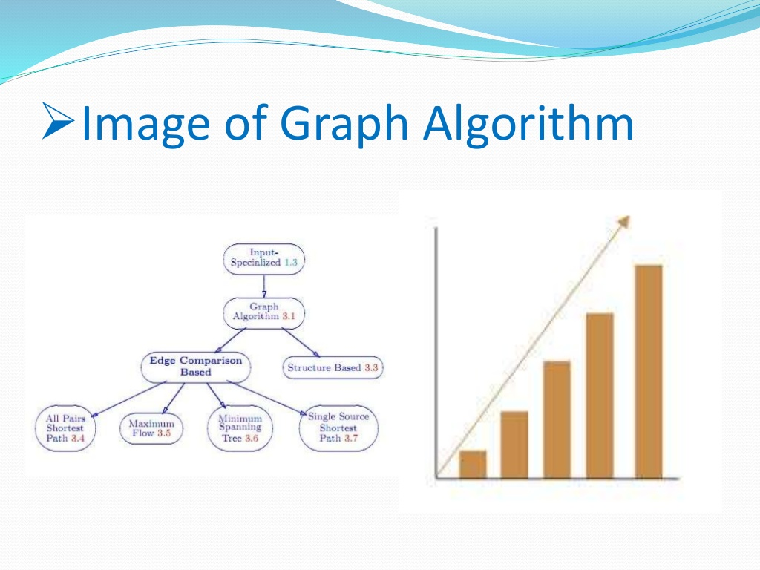
Graph Algorithms

Slide 41

Solution for a given Problem?
design
input Algorithm output
specifications (a way for finding its solu.) specifications
encode
Program Input “computer” Program output
Program code
Figure 1.0 Notion of Algorithm

Slide 42
Several characteristics of Algorithms:
[Non-ambiguity] The non-ambiguity requirement for each step of an algorithm cannot be compromised.
Prime Factorization in Middle School Procedure for computing gcd(m, n) is defined ambiguously
[Well-specified inputs’ range] The range of inputs an algorithm works has to be precisely specified.
Consecutive integer checking algorithm for computing gcd(m, n) does not work correctly when one of the input numbers is zero.
…

Slide 43
Several characteristics of Algorithms:
[Different ways for specifying an algorithm] The same algorithm can be written in different ways.
Euclid’s algorithm can be defined recursively or non-recursively.
[Several algorithms for a problem] Several algorithms for solving the same problem may exist.
Euclid, Consecutive Integer Checking, and Middle School Procedure for computing gcd(m, n)
…

Slide 44
Several characteristics of Algorithms:
…
[Various Speeds of different Algorithms for solving the same problem] Algorithms for the same problem can be based on very different ideas and can solve the problem at dramatically different speeds.
An exponential algorithm Fibonacci_Number_F(n) computes recursively the list of the n Fibonacci members based on its definition, and
a polynomial Algorithm_Fib(n) computes non-recursively the list of its n members.

Slide 45
Input Size
For many algorithms, a reasonable measure of the input size – is the size of the input.
For example, the input size is the number n of items in the array for sequential search, sorting, and binary search algorithms.
Some algorithms use two numbers to measure the size of the input.
For example, when a graph G = (V, E) is the input to an algorithm, the input size consists of both parameters: number of vertices |V| and edges |E|.

Slide 46
Input Size
Must be cautious about calling a parameter the input size. For example,
Algorithm Euclid (m, n) computes the greatest common divisor of two numbers m and n,
Algorithm Sieve(n) finds all prime numbers less than or equal to n using the sieve of Eratosthenes method,
Algorithm Fibonacci_Number_F(n) computes recursively the list of the n Fibonacci members based on its definition, and
Polynomial_Algorithm_Fib(n) computes non-recursively the list of its n members.
The input m and n should NOT be called the input size.
Are the values of the parameters, m, and n, the input size?

Slide 47
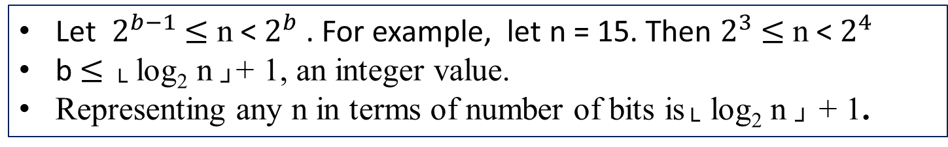
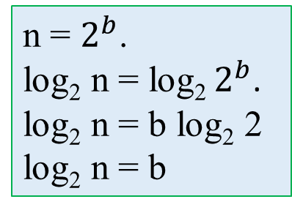
Input Size
For these algorithms: Algorithm Euclid (m, n), Algorithm Sieve(n), Algorithm Fibonacci_Number_F(n), Polynomial_Algorithm_Fib(n), and many others,
a reasonable measure of the input size is
the number of symbols used to encode n.
When the binary representation is used,
the input size will be the number of bits it takes to encode n,
└ log₂ n ┘ + 1.
For example:
n = $2^{b}$.
log₂ n = log₂ $2^{b}$.
log₂ n = b log₂ 2
log₂ n = b
Let $2^{b−1}$ $≤$ n < $2^{b}$ . For example, let n = 15. Then $2^{3}$ $≤$ n < $2^{4}$
b $≤$ └ log₂ n ┘+ 1, an integer value.
Representing any n in terms of number of bits is└ log₂ n ┘ + 1.

Slide 48
Input Size
For a given algorithm, the input size is defined as
the number of characters it takes to write the input.

Slide 49
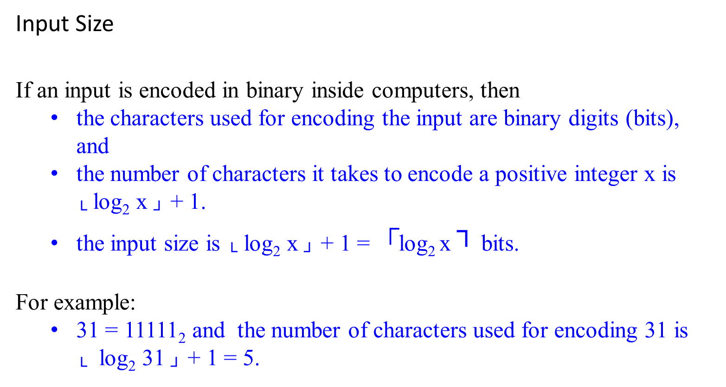
Input Size
If an input is encoded in binary inside computers, then
the characters used for encoding the input are binary digits (bits), and
the number of characters it takes to encode a positive integer x is └ log₂ x ┘ + 1.
the input size is └ log₂ x ┘ + 1 = $┌$log₂ x ┐ bits.
For example:
31 = 11111₂ and the number of characters used for encoding 31 is └ log₂ 31 ┘ + 1 = 5.

Slide 50
Modeling the Real World- Develop a realistic model for the input
Cast your application in terms of well-studied abstract data structures
Concrete | Abstract
arrangement, tour, ordering, sequence | permutation
cluster, collection, committee, group, packaging, selection | subsets
hierarchy, ancestor/descendants, taxonomy | trees
network, circuit, web, relationship | graph
sites, positions, locations | points
shapes, regions, boundaries | polygons
text, characters, patterns | strings

Slide 51
Real-World Applications
Hardware design: VLSI chips
Compilers
Computer graphics: movies, video games
Routing messages on the Internet
Searching the Web
Distributed file sharing
Computer-aided design and manufacturing
Security: e-commerce, voting machines
Multimedia: CD player, DVD, MP3, JPG, HDTV
DNA sequencing, protein folding
and many more!

Slide 52
The Objectives of the Course
1. Be able to identify and abstract computational problems.
Know important algorithmic techniques and a range of useful algorithms.
Be able to implement algorithms as a solution to any solvable problem.
Be able to analyze the complexity and correctness of algorithms.
5. Be able to design correct and efficient algorithms.

Slide 53
Separation of behavior and implementation

Slide 54
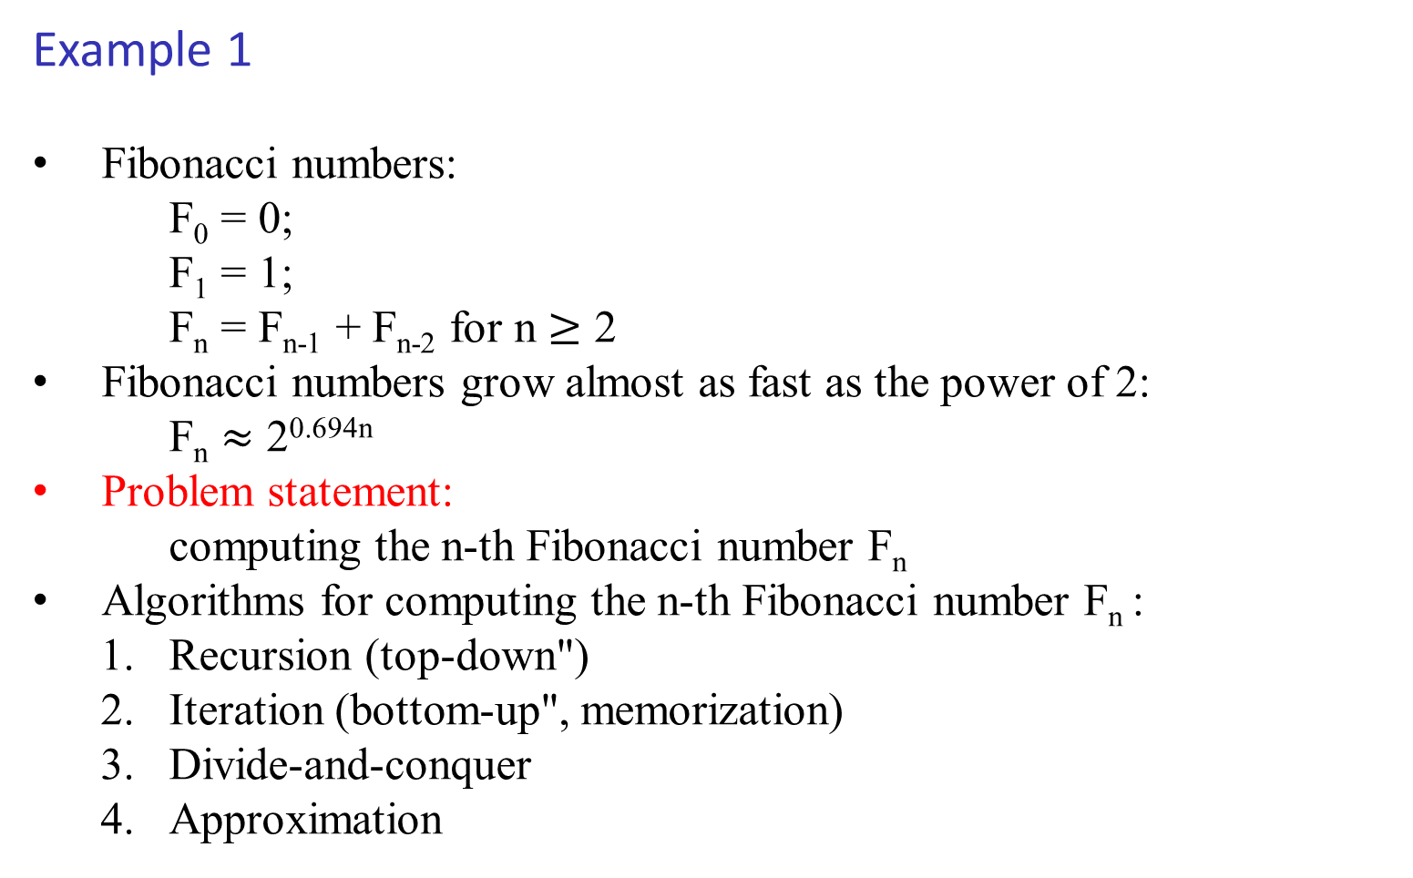
Example 1
Fibonacci numbers:
F₀ = 0;
F₁ = 1;
F_{n} = F_{n-1} + F_{n-2} for n $≥$ 2
Fibonacci numbers grow almost as fast as the power of 2:
F_{n} $≈$ 2^{0.694n}
Problem statement:
computing the n-th Fibonacci number F_{n}
Algorithms for computing the n-th Fibonacci number F_{n} :
Recursion (top-down")
Iteration (bottom-up", memorization)
Divide-and-conquer
Approximation

Slide 55
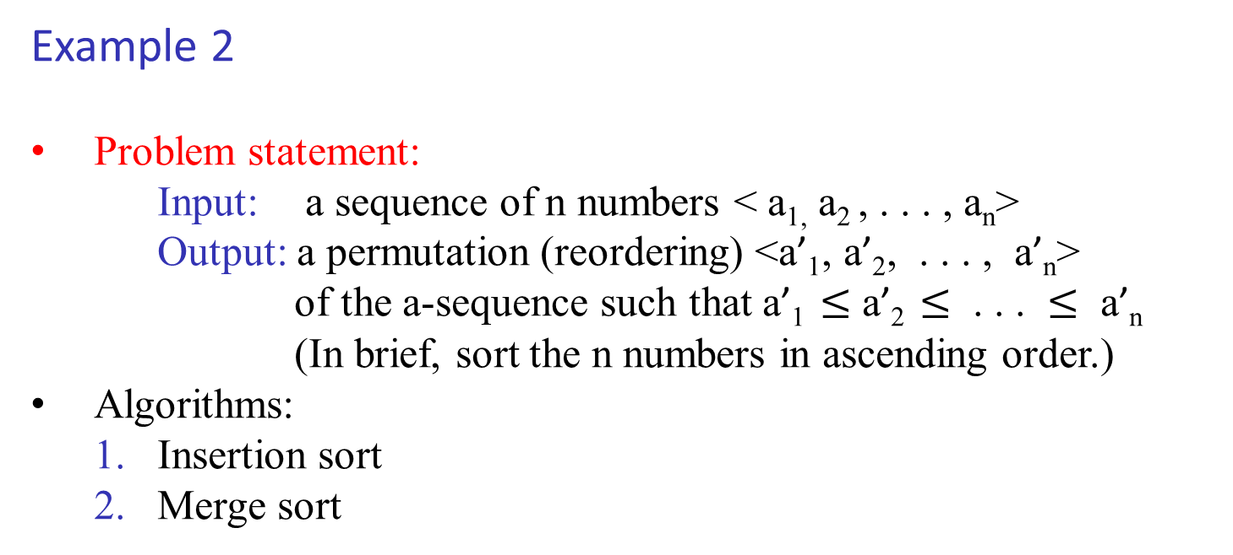
Example 2
Problem statement:
Input: a sequence of n numbers < a_{1,} a₂ , . . . , a_{n}>
Output: a permutation (reordering) <a’₁, a’₂, . . . , a’_{n}>
of the a-sequence such that a’₁ $≤$ a’₂ $≤$ . . . $≤$ a’_{n}
(In brief, sort the n numbers in ascending order.)
Algorithms:
1. Insertion sort
2. Merge sort

Slide 56
Example 2: Insert sort algorithm
Idea: incremental approach
Pseudocode
InsertionSort(A)
n = length(A);
for (j = 2 to n) {
key = A[j];
// insert ``key'' into sorted array A[1...j-1]
i = j-1;
while (i > 0 and A[i] > key) do {
A[i+1] = A[i];
i = i - 1;
} //end while
A[i+1] = key;
} //end for
return A;

Slide 57
Example 2: Insert sort algorithm
Remarks:
Correctness: argued by “loop-invariant” (a kind of induction)
Complexity analysis:
best-case
worst-case
average-case
Insertion sort is a “sort-in-place”, no extra memory is necessary
Importance of writing good pseudocode = “expressing algorithm to human”
There is a recursive version of insertion sort (can you do it)

Slide 58
Example 2: Merge sort algorithm
Idea: a divide-and-conquer approach
Pseudocode
MergeSort(A, p, r) // Merge-sort of array A[p..r]
if (p < r) then // check for base case
q = flooring( (p+r)/2 ) // divide
MergeSort(A, p, q) // conquer
MergeSort(A, q+1, r) // conquer
Merge(A, p, q, r) // combine
end if

Slide 59
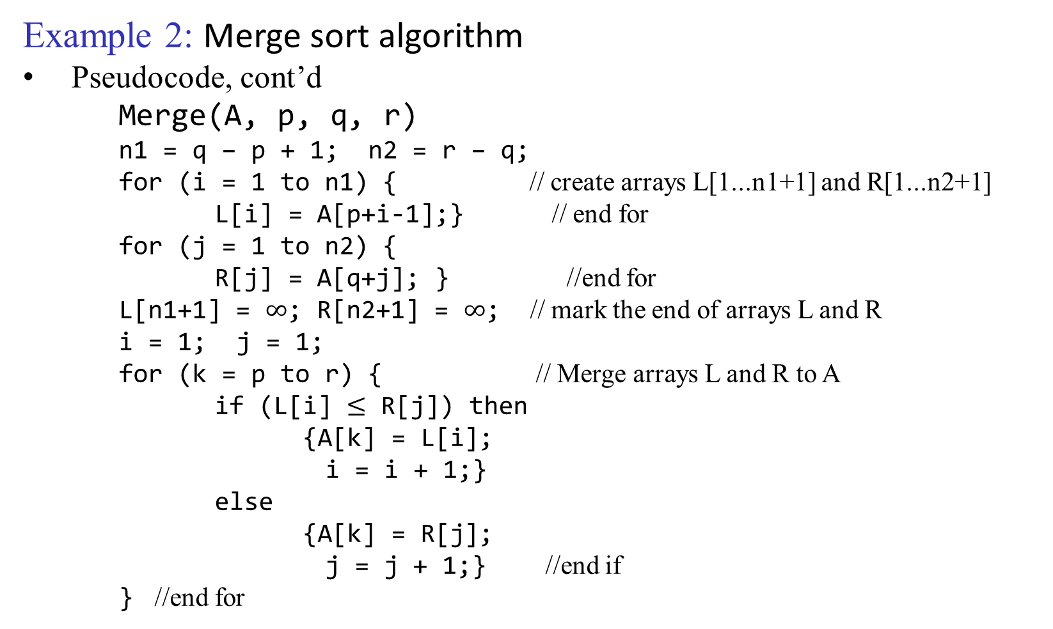
Example 2: Merge sort algorithm
Pseudocode, cont’d
Merge(A, p, q, r)
n1 = q – p + 1; n2 = r – q;
for (i = 1 to n1) { // create arrays L[1...n1+1] and R[1...n2+1]
L[i] = A[p+i-1];} // end for
for (j = 1 to n2) {
R[j] = A[q+j]; } //end for
L[n1+1] = $∞$; R[n2+1] = $∞$; // mark the end of arrays L and R
i = 1; j = 1;
for (k = p to r) { // Merge arrays L and R to A
if (L[i] $≤$ R[j]) then
{A[k] = L[i];
i = i + 1;}
else
{A[k] = R[j];
j = j + 1;} //end if
} //end for

Slide 60
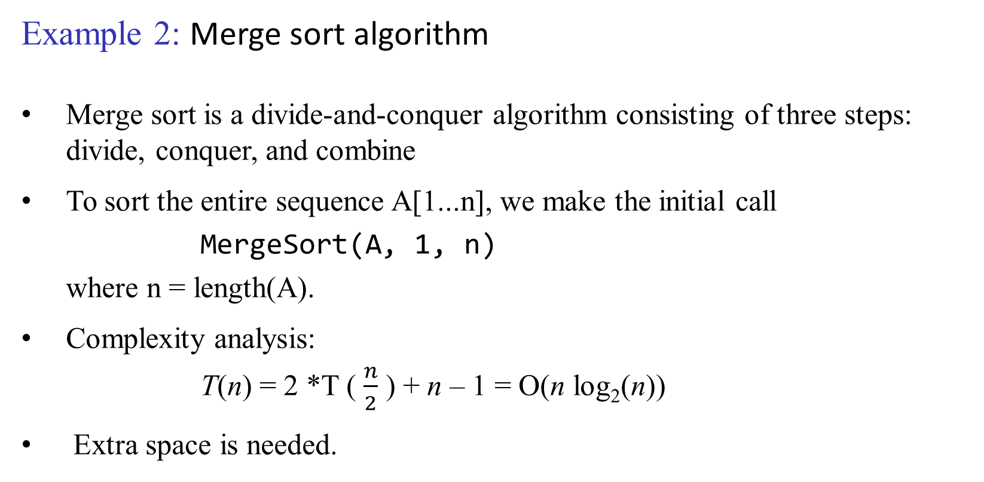
Example 2: Merge sort algorithm
Merge sort is a divide-and-conquer algorithm consisting of three steps: divide, conquer, and combine
To sort the entire sequence A[1...n], we make the initial call
MergeSort(A, 1, n)
where n = length(A).
Complexity analysis:
T(n) = 2 *T ( $\frac{n}{2}$ ) + n – 1 = O(n log₂(n))
Extra space is needed.

